Slide 1
“PHP on Windows“ installation and management
Juozas Kaziukėnas
www.juokaz.com / juozas@juokaz.com / @juokaz

Slide 2
Me
Juozas Kaziukėnas
Live in Edinburgh, UK
Student in University of Edinburgh
Software developer, consultant and evangelist
Speaker in PHP conferences all over the world
Open source developer (Zend Framework, Doctrine etc.)
Somewhat related to Microsoft...
More info www.juokaz.com and @juokaz

Slide 3
You
PHP developers?
Using Linux for production servers?
Using Windows for workstations?

Slide 4
PHP on Windows
Installation and management

Slide 5

Why?

Slide 6
Why?
PHP is the most popular language , 75% of all websites
http://bit.ly/bmCvms
Enterprise/business environments
Windows are very popular there
Integration with Windows applications and tools
SQL Server etc.
Microsoft’s wish

Slide 7

No-one wants to migrate to Windows

Slide 8
No-one wants to migrate to Windows
And no-one asks for it
Changing working systems is stupid and prone to errors and downtime
Important:
Using in existing Windows systems
Maybe for new projects
It’s good to know that “it works”

Slide 9

History

Slide 10
History
2006
PHP and Windows = ☹
2007
FastCGI
2008
PHP 5.3 and windows.php.net
2010
2009
PHP 5.3 release
WinCache 1.0
FastCGI 1.5
WinCache 1.1

Slide 11
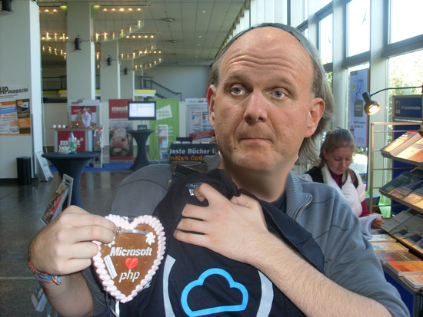
PHP and Microsoft

Slide 12

PHP and Microsoft

Slide 13
Today
Community’s and Microsoft’s initiatives
Used in production
A lot of tools for developers
Work on interoperability is done on daily basis

Slide 14
Installation

Slide 15
WebDeploy
Deploy tool
Allows migrating IIS 6 -> IIS 7
Configuration, source code, DB’s, DLL’s etc.
Dependencies
Servers synchronization
No admin permissions are required

Slide 16
Web Platform Installer
Using WebDeploy
Web server setup with one click
IIS, PHP, Microsoft SQL Server, .Net etc.
Web App Gallery
Drupal, Wordpress etc.

Slide 17
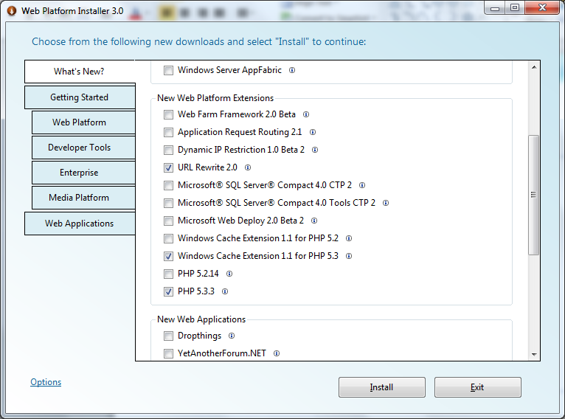
Web Platform Installer

Slide 18
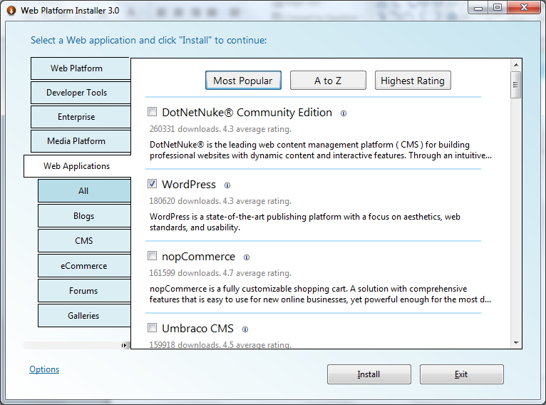
Web App Gallery

Slide 19
IIS tools

Slide 20
PHP Manager for IIS
Straightforward way to manage multiple PHP versions
Configuration editing in UI (no need to touch php.ini)
No restart of IIS is needed because of FastCGI 7.5
Also managing extensions and errors’ level
Websites can have different PHP versions configured

Slide 21
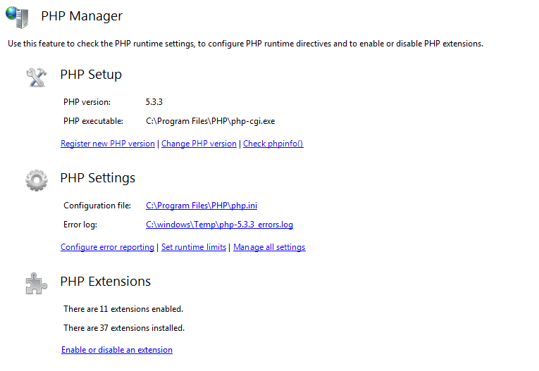
PHP Manager for IIS

Slide 22
URL Rewrite
Similar to Apache mod_rewrite
Probably has more features
Not always easier to use
UI tool
.htaccess import!

Slide 23
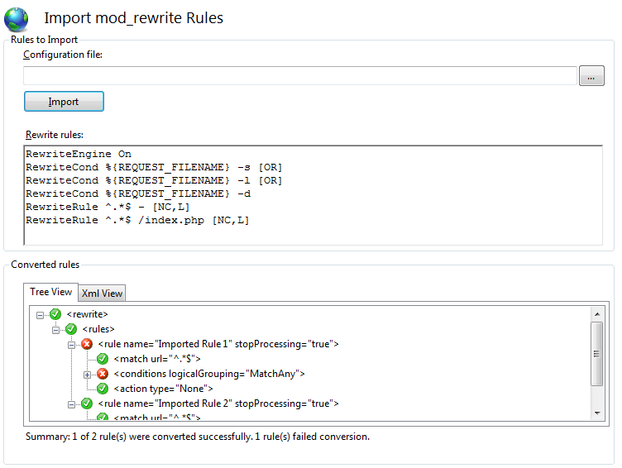
URL Rewrite

Slide 24
Much more
WinCache
Logging
Warm up
Database manager
SEO toolkit
Etc.

Slide 25
Windows support

Slide 26
SQL server driver (SQLSRV)
Finally possible to use SQL Server databases flawlessly
All previous drivers’ problems are fixed
Sqlsrv 2.0 contains PDO adapter also
It works, used in practice:
Zend Framework was first to introduce Sqlsrv support
Doctrine 2.0 will be a major Sqlsrv provider
Currently only works on Windows

Slide 27
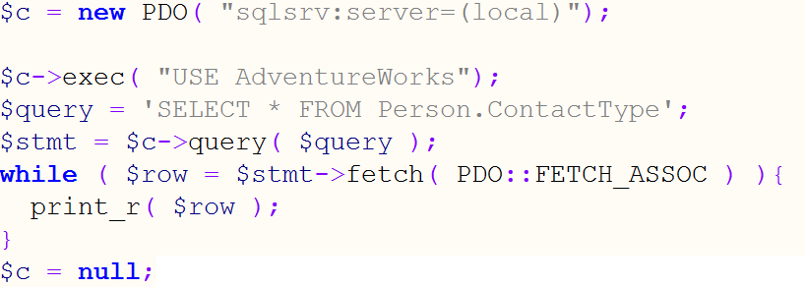
SQL server driver (SQLSRV)

Slide 28
Windows Azure
Supports PHP applications
Google AppEngine doesn’t support PHP
PHP runtime contained within application
Ready to use libraries for consuming Azure services
http://phpazure.codeplex.com/
WebDeploy is used for deploying applications

Slide 29
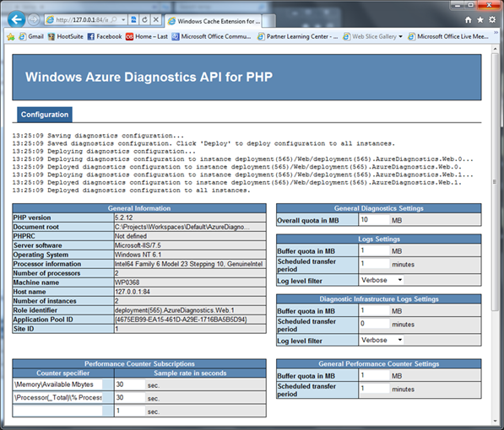
Windows Azure

Slide 30
PHP projects
More and projects are officially supporting Windows
Most of the big ones: Drupal, phpBB, Wodpres etc.
Microsoft are helping them
Usually it only requires small changes
SQL Server support is growing also

Slide 31

Finishing touches

Slide 32
Questions?

Slide 33
Thanks!
Slides will be available online soon
Contact me on:
www.juokaz.com
juozas@juokaz.com
Twitter: @juokaz
* illustrations from sxc.hu and images.google.com

